Slide 1

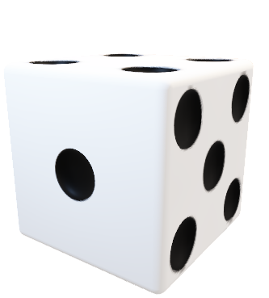
RichUp.io
Mariana Andrade 103823
Vicente Barros 97787
Multimodal Interaction
2023/24

Slide 2

RichUp.io
Application
Scenario
Fusion
Implementation
Limitations

Slide 3

RichUp.io
Application
Richup.io is a free online alternative to the classic board game Monopoly.
Roll Dices
Buy Houses
Trade with other players
Customize player’s character
Check House Information

Slide 4
RichUp.io
Application
Scenario
Fusion
Implementation
Limitations

Slide 5
RichUp.io
Scenario
#1: Rolling the Dice
Given a player is ready to take their turn
When the player performs a swiping gesture over the device’s sensor
Then the game should recognize this gesture as a dice roll and make the move

Slide 6
RichUp.io
Scenario
#2: Buying a Property
Given a player lands on an unowned property,
When the player makes a tapping gesture over an hand from another
Then it should be recognized as an intent to buy the property and deduct the property cost from the player's game currency.

Slide 7
RichUp.io
Application
Scenario
Fusion
Implementation
Limitations

Slide 8
RichUp.io
Fusion

Slide 9
RichUp.io
Fusion
Single

Slide 10
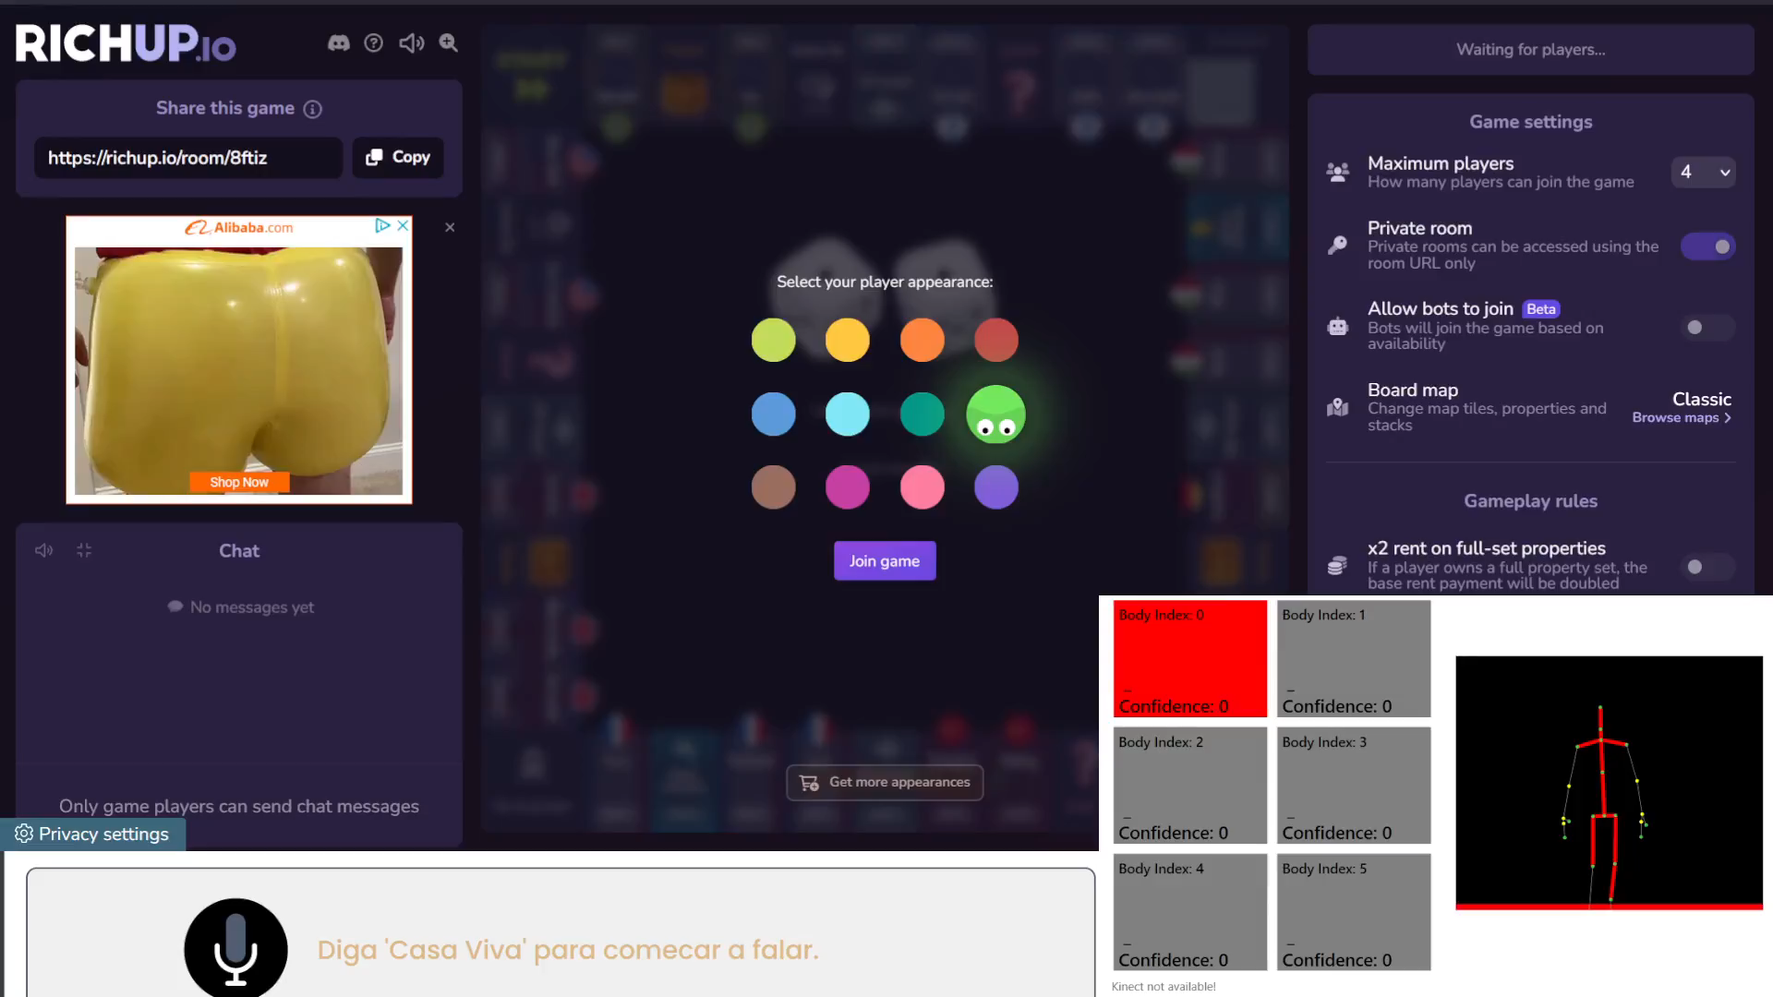

Select - Gesture

Slide 11
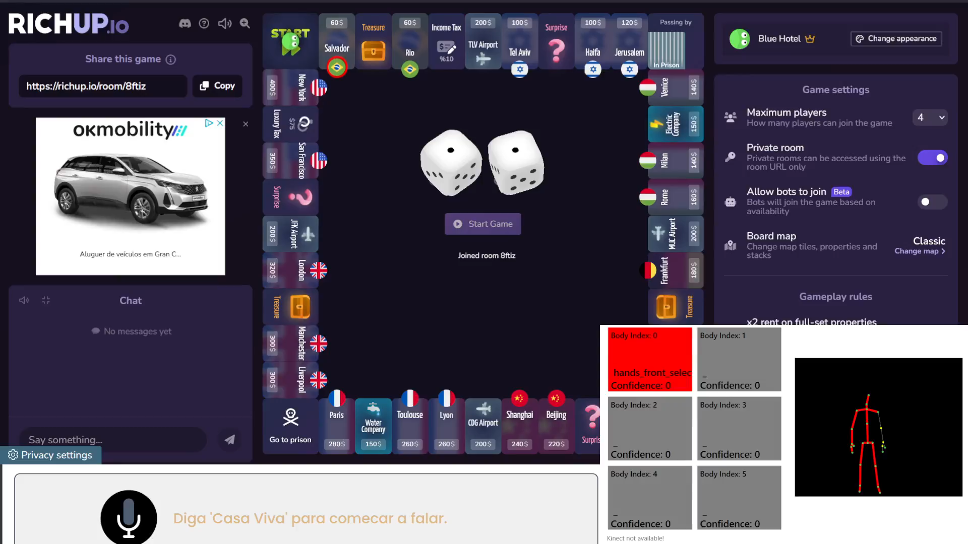
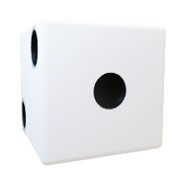
Select - Gesture

Slide 12
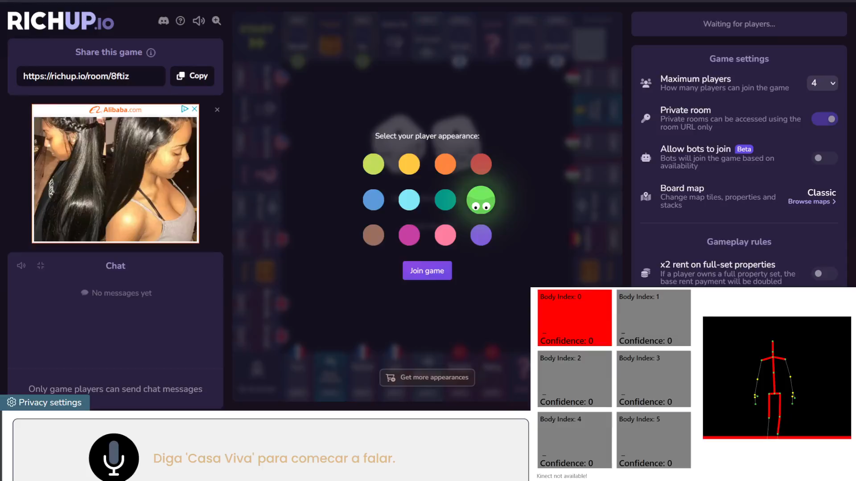
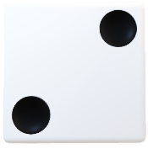
Choose Colour - Voice

Slide 13
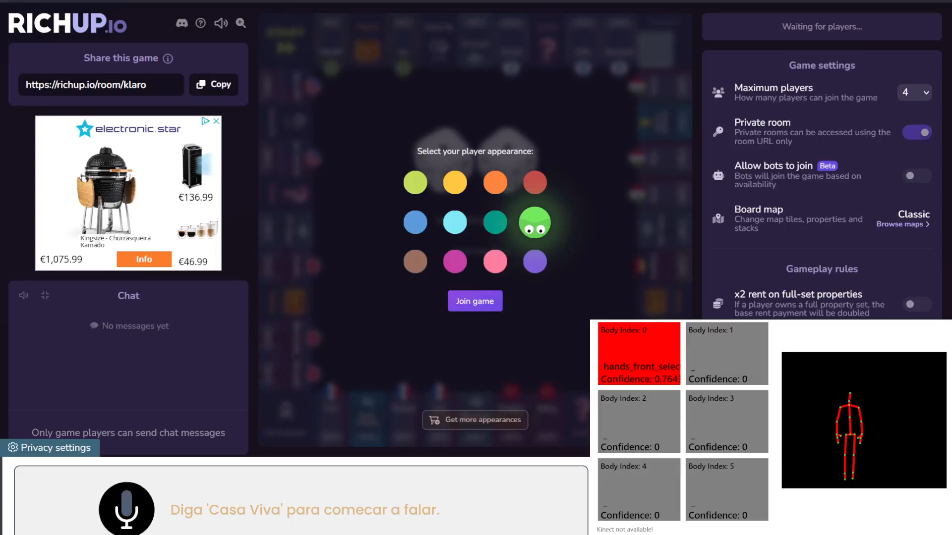
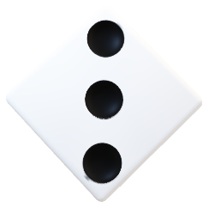
List of Colours - Voice

Slide 14
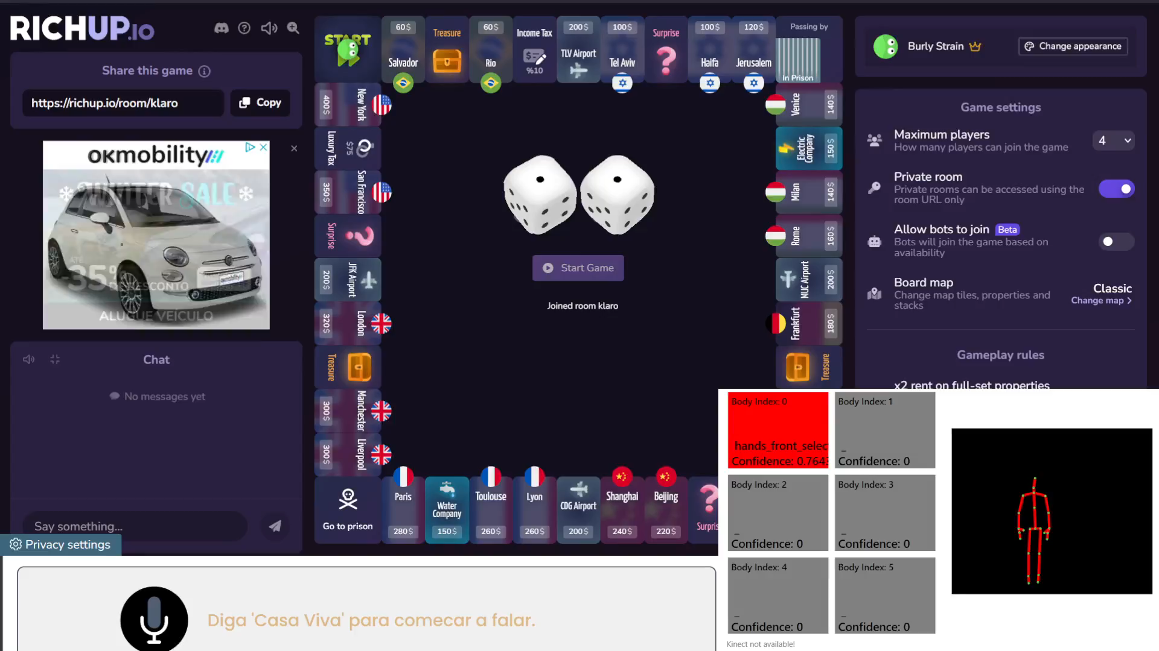
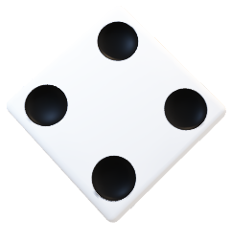
Game Information - Voice

Slide 15
RichUp.io
Fusion
Redundancy

Slide 16
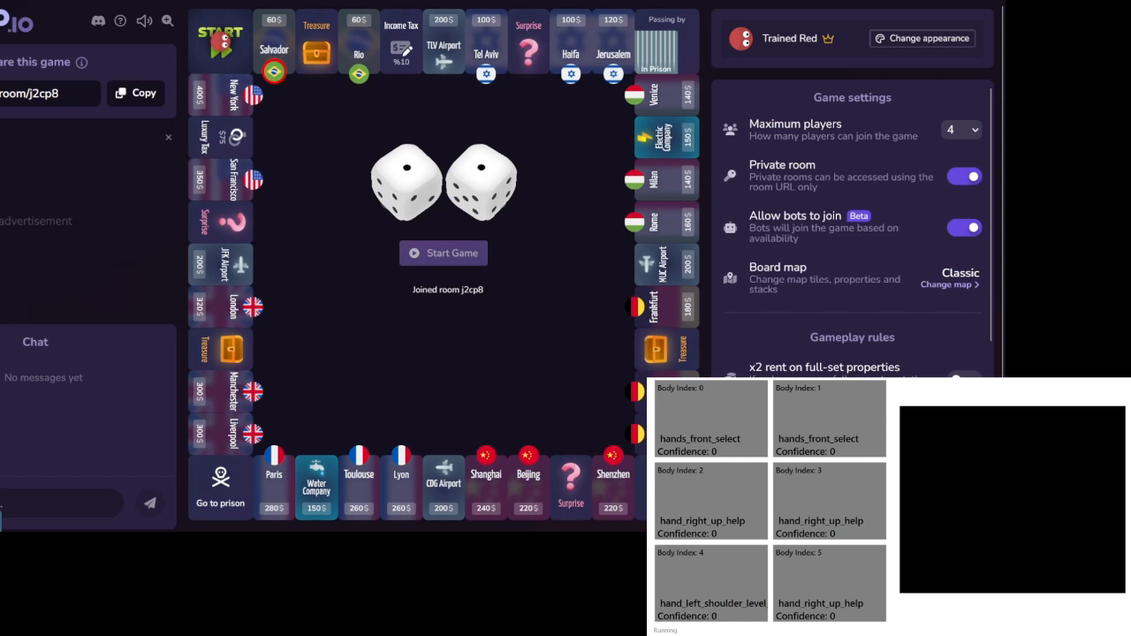
Roll Dice - Gesture

Slide 17
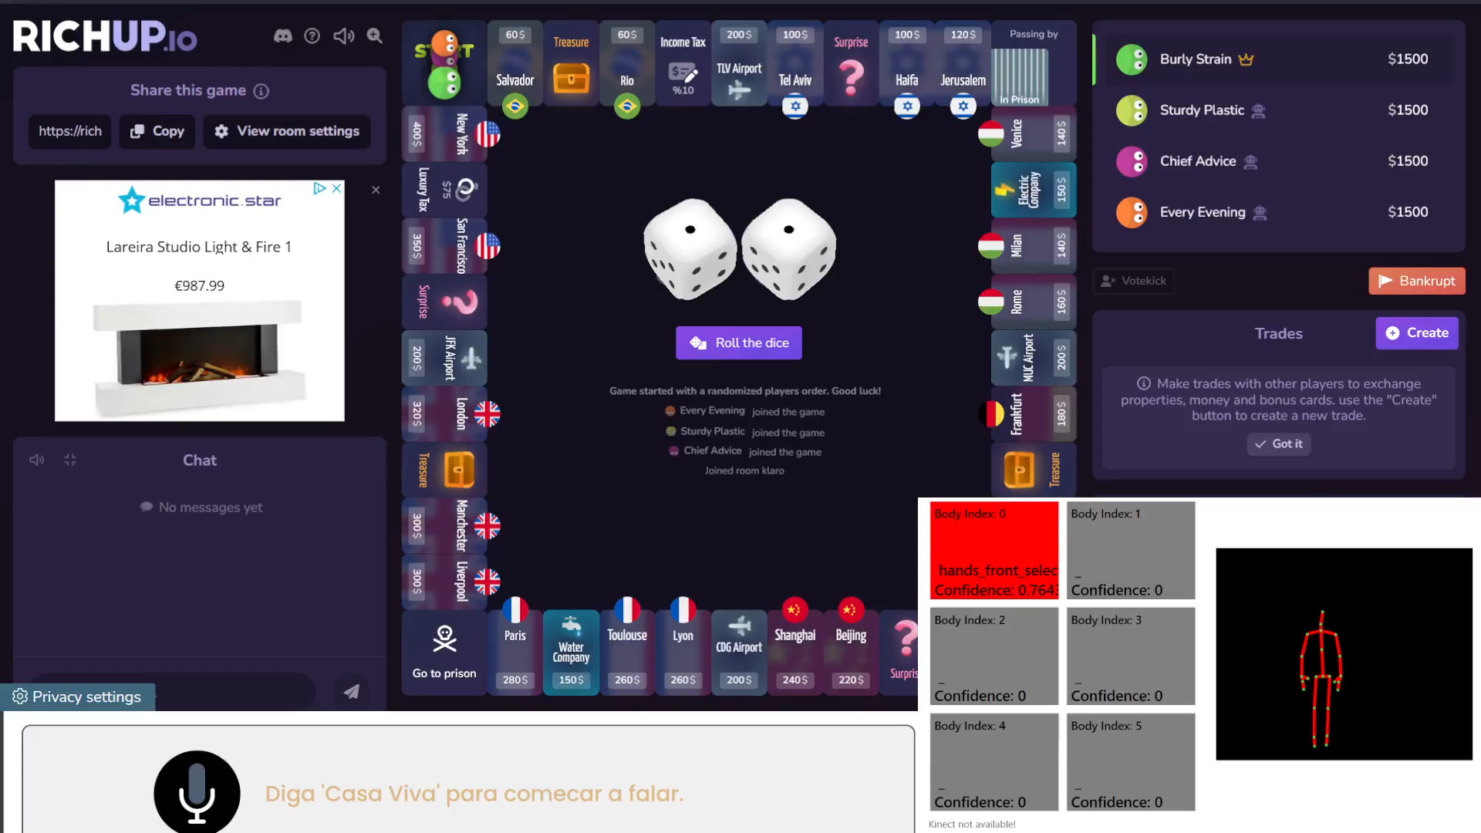
Roll Dice - Voice

Slide 18
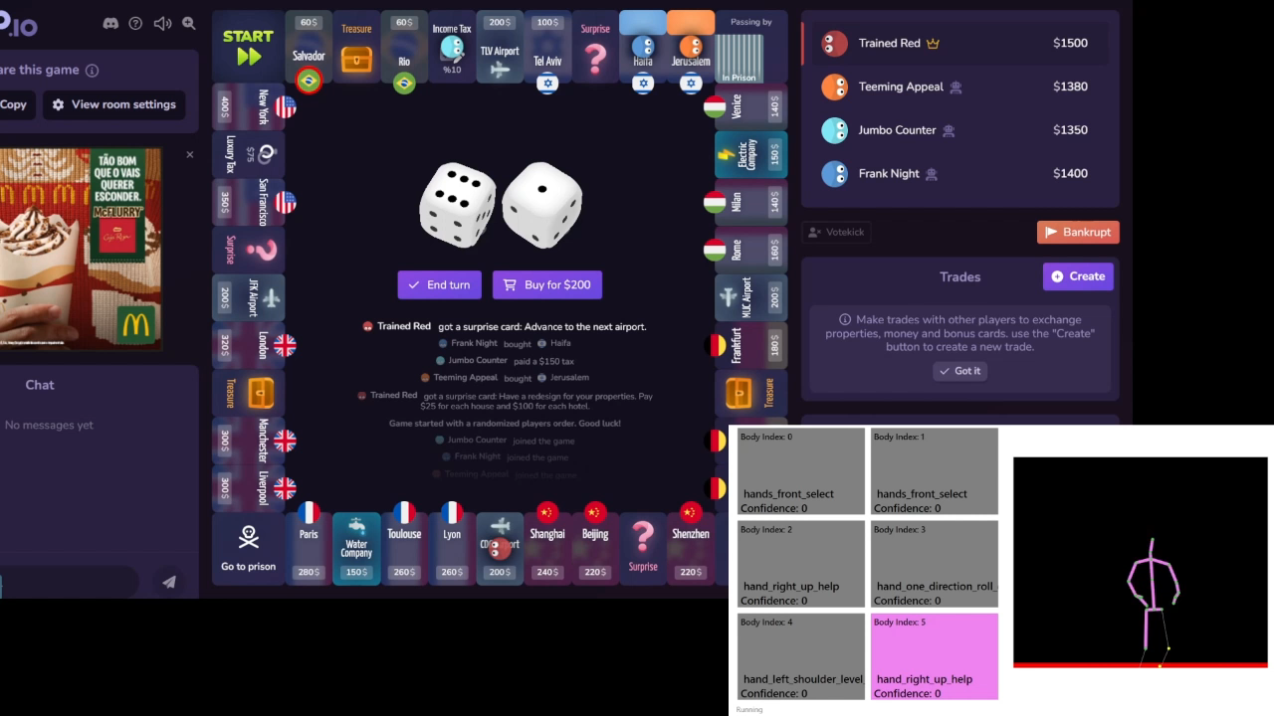
Buy House - Gesture

Slide 19
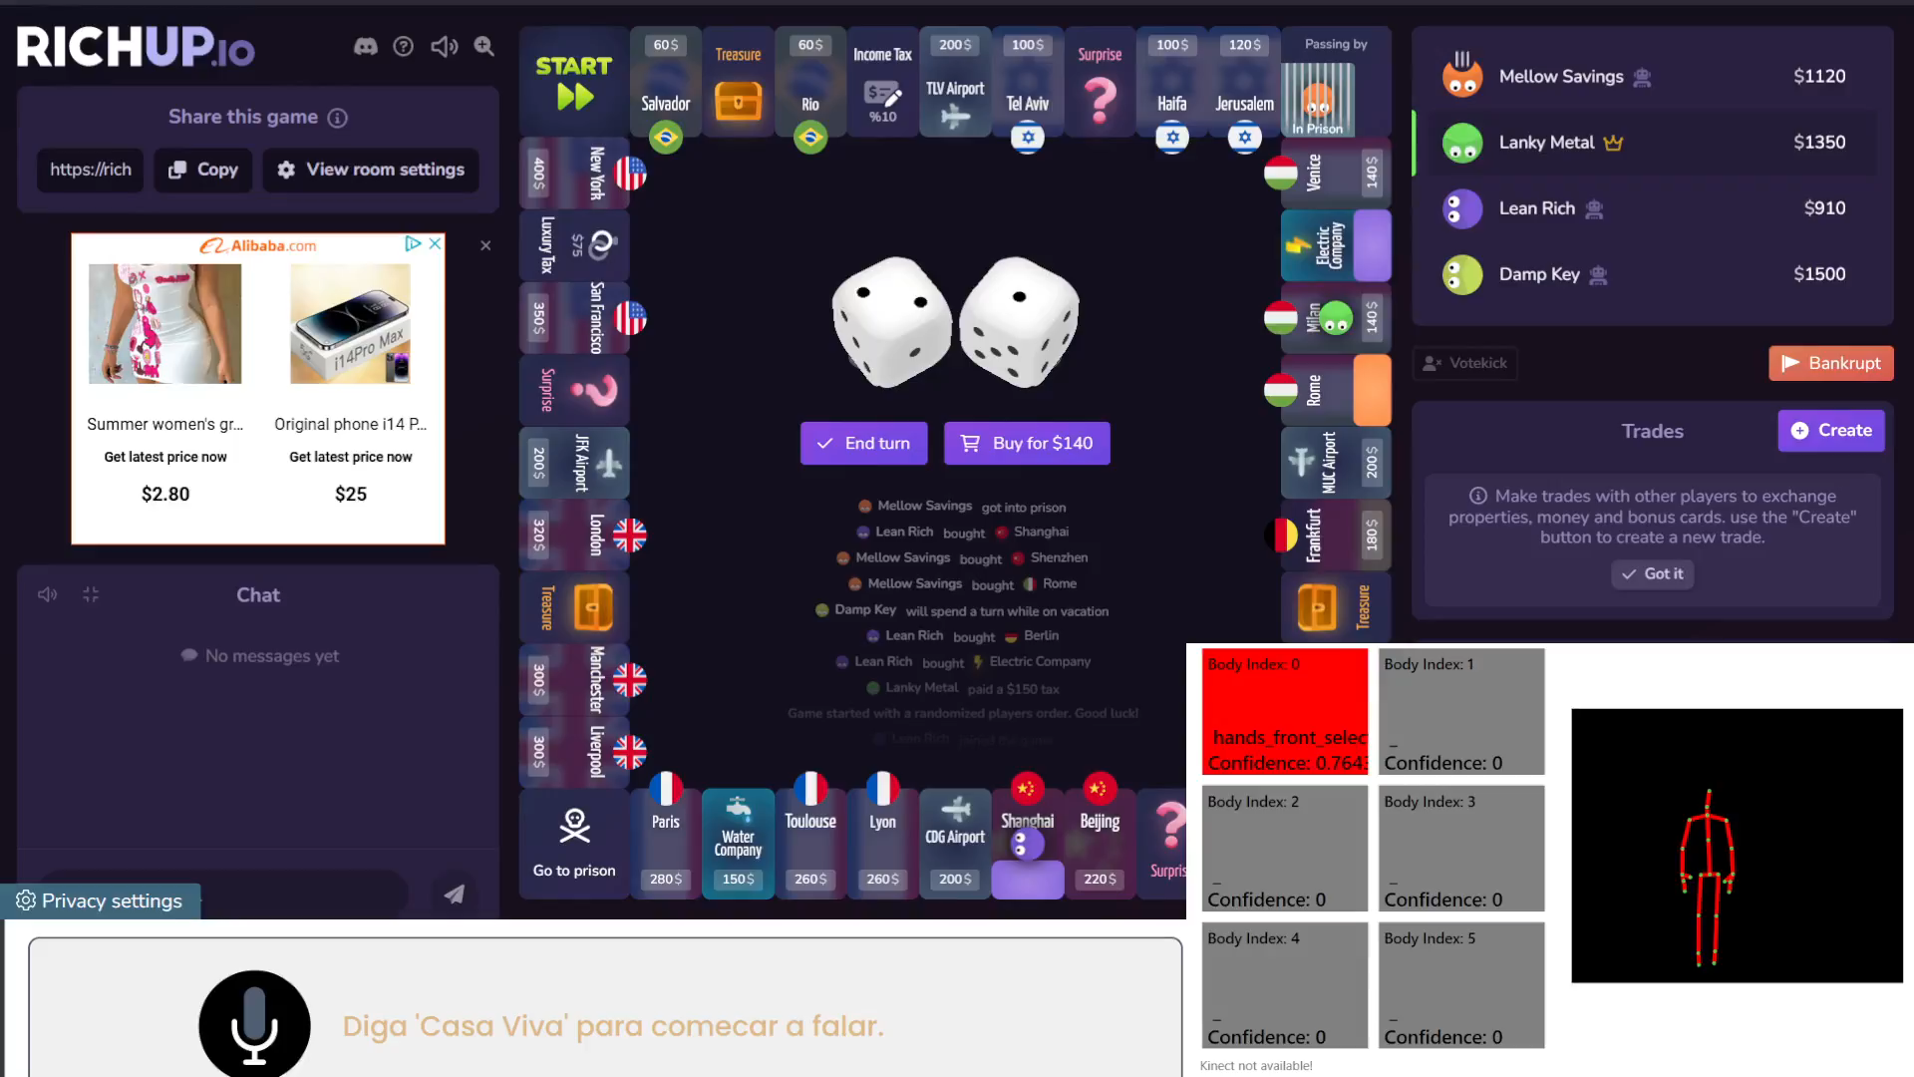
Buy House - Voice

Slide 20
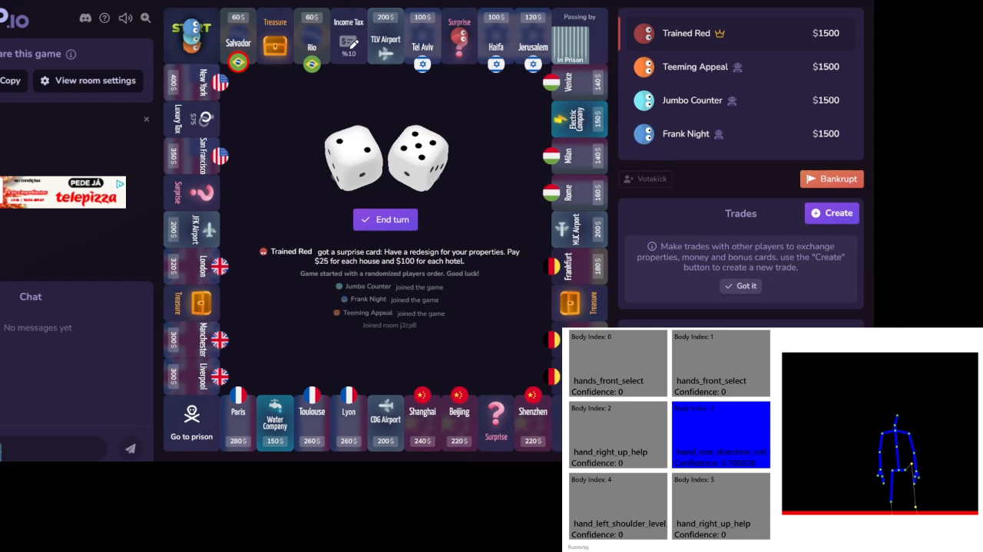
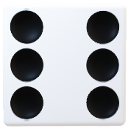
End Turn - Gesture

Slide 21
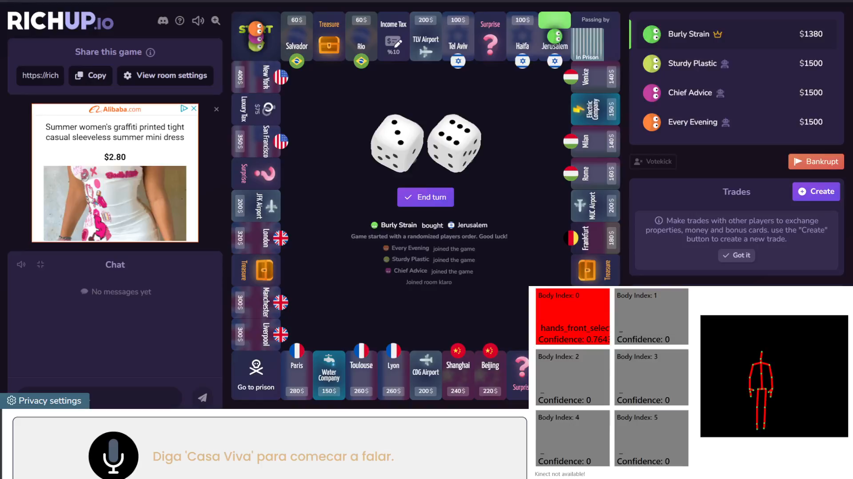
End Turn - Voice

Slide 22
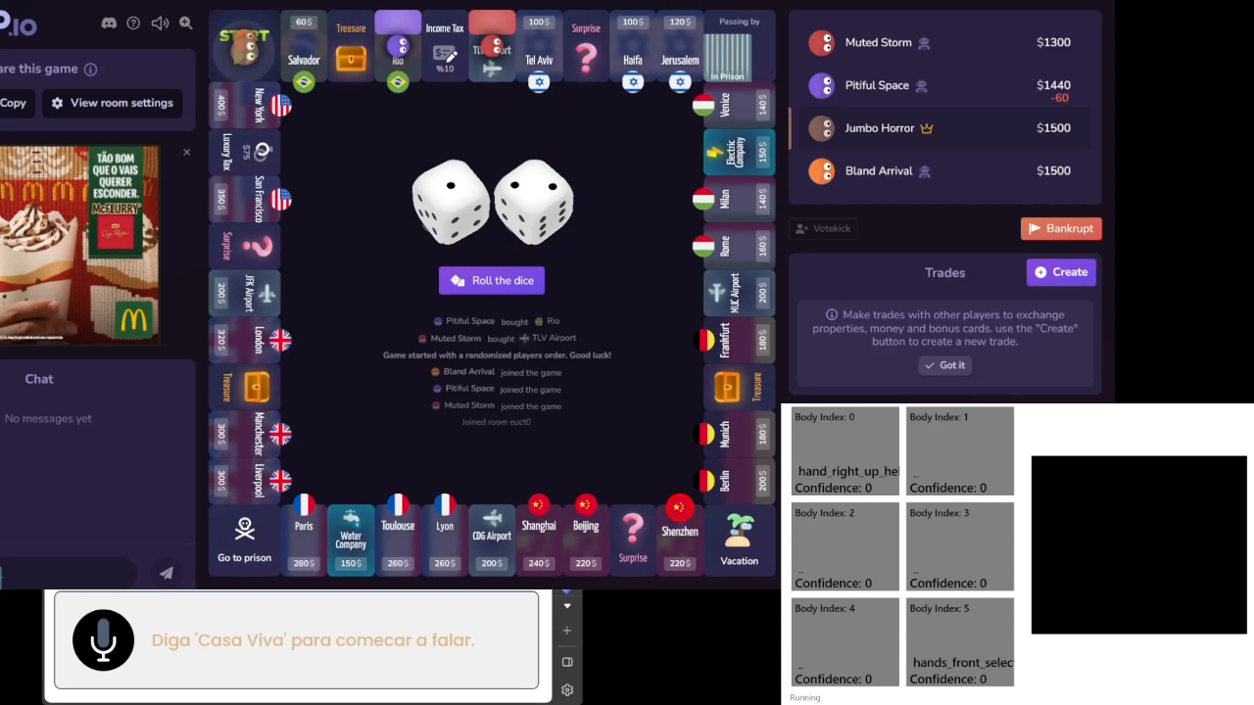
Give Up - Gesture

Slide 23
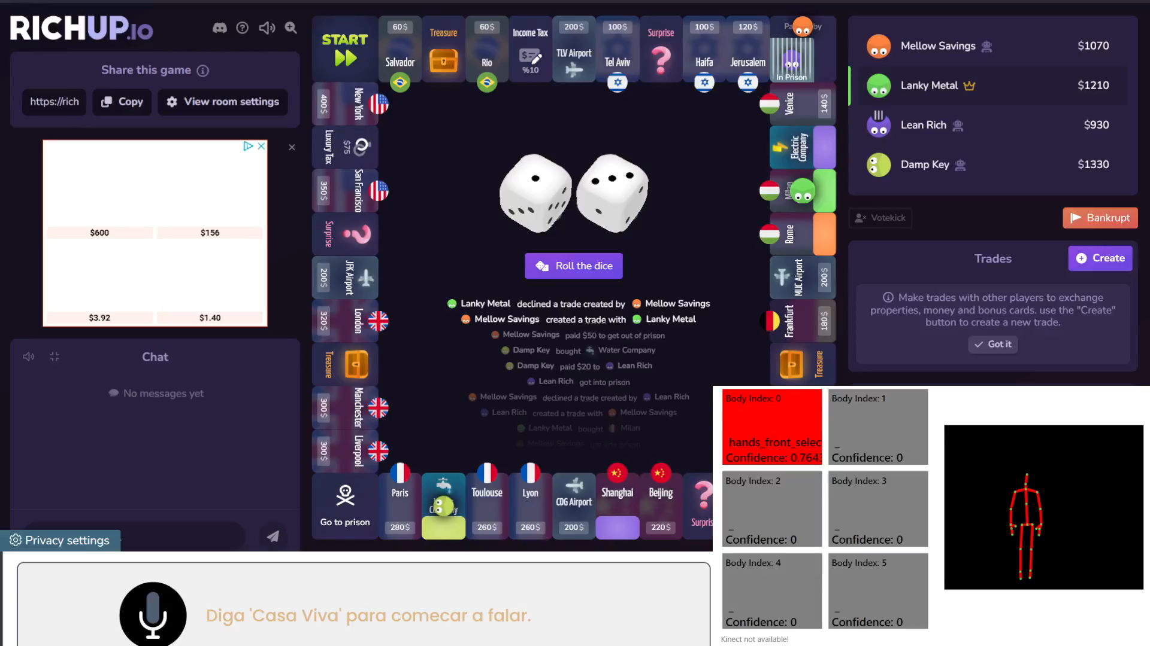
Give Up - Voice

Slide 24
RichUp.io
Fusion
Complementary

Slide 25
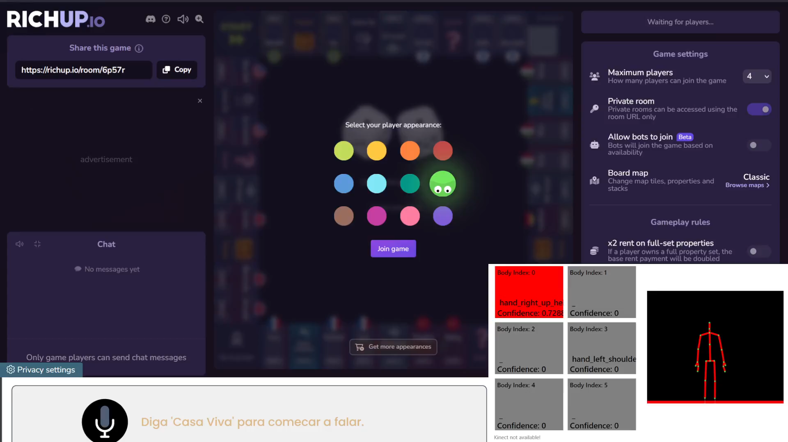
Help + List of Colours

Slide 26
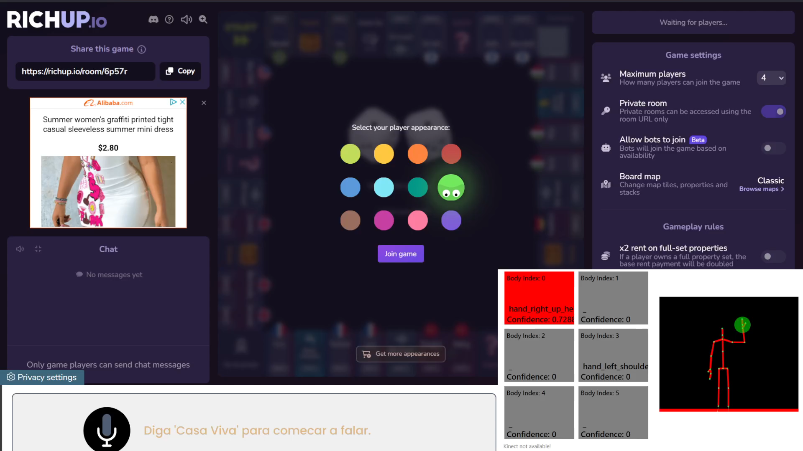
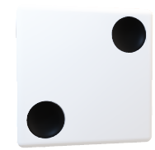
Help + Game Information

Slide 27
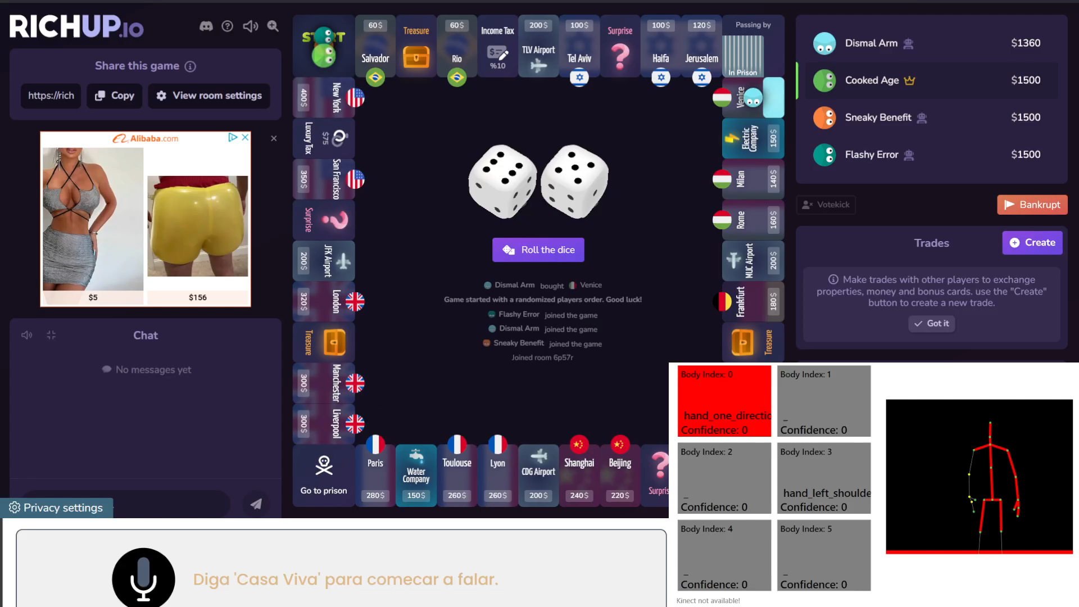
Roll Dice and Buy House

Slide 28
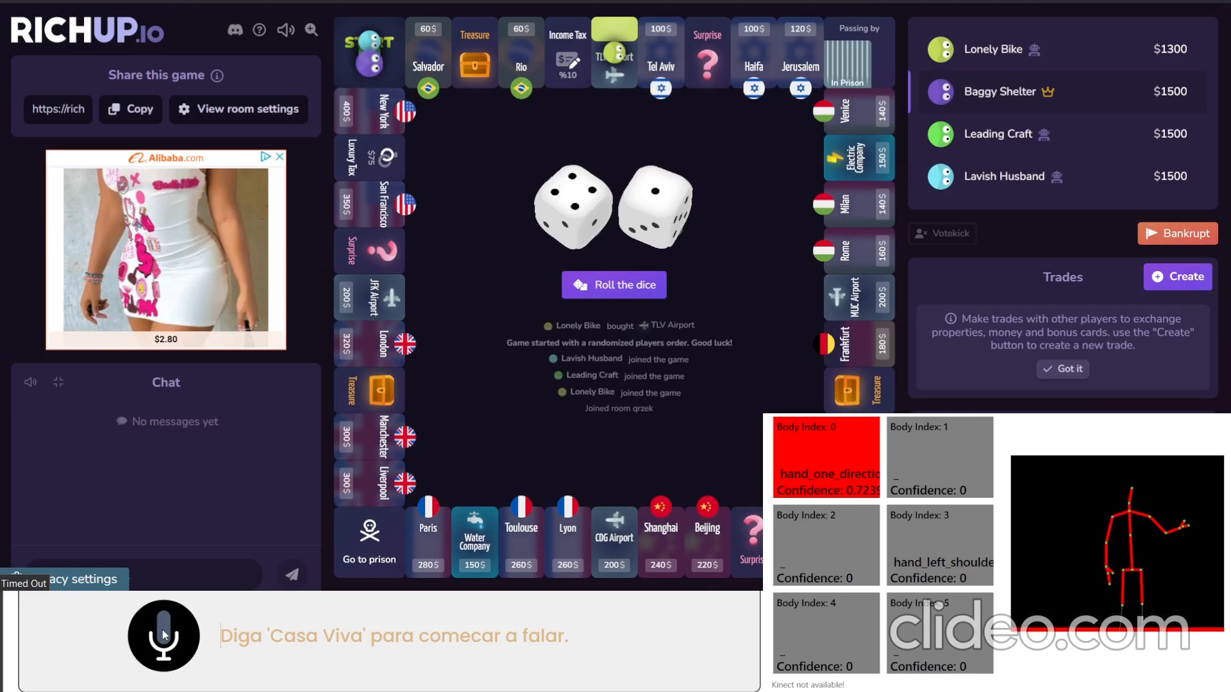
Completed The Best Move

Slide 29
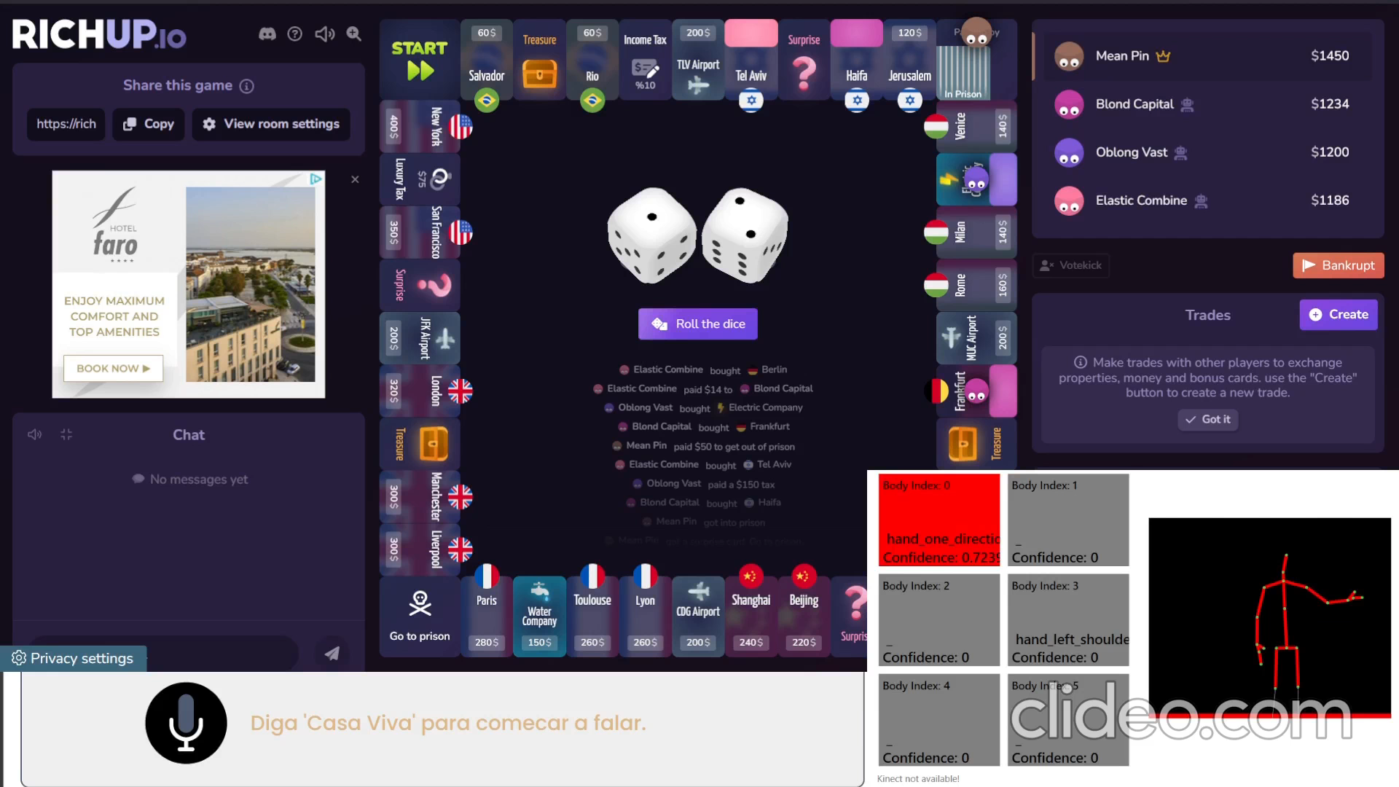
Completed The Best Move

Slide 30
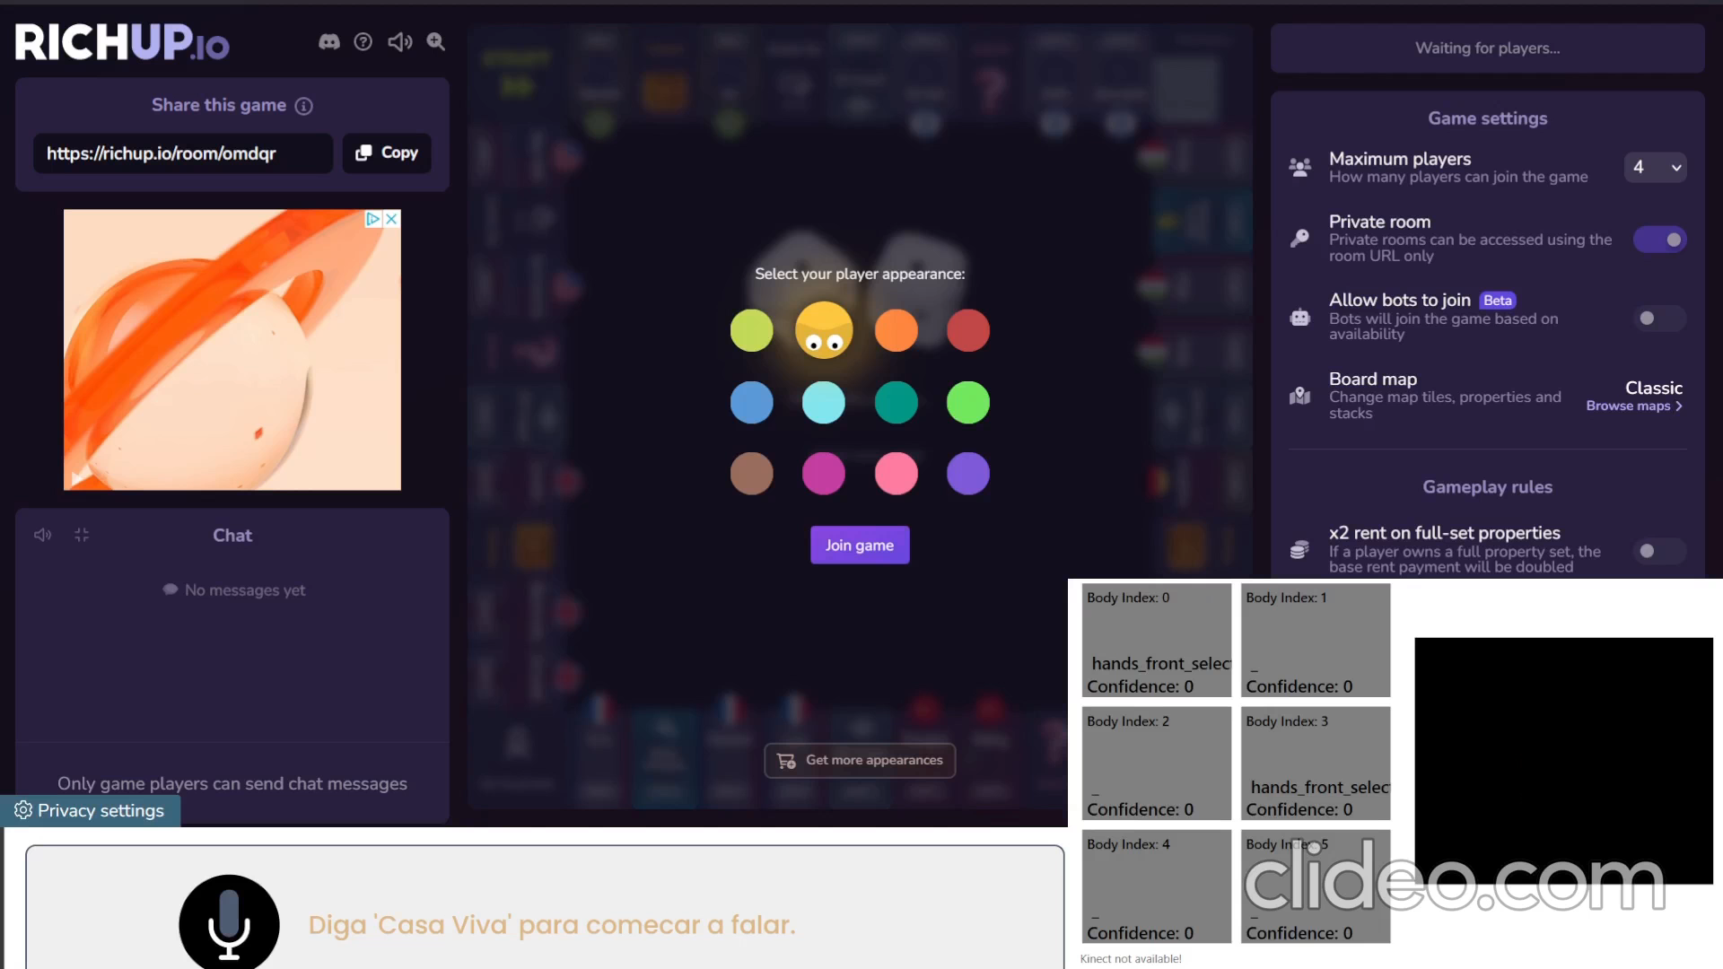
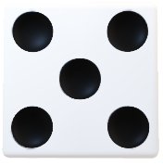
Full Colours Interaction

Slide 31
RichUp.io
Application
Scenario
Gestures
Implementation
Limitations

Slide 32
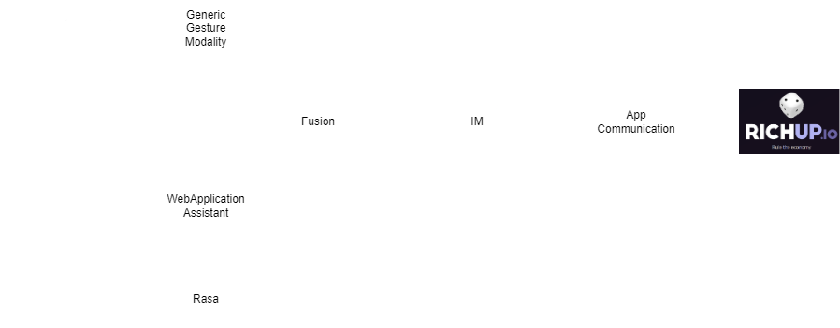
RichUp.io
Implementation

Slide 33
RichUp.io
Application
Scenario
Gestures
Implementation
Limitations

Slide 34
RichUp.io
Limitations
The main challenge was the recording in different places.
Even with a reasonable number of examples and the use of negative examples, the Kinect struggled to identify some gestures

Slide 35
Live Demo

